Slide 1
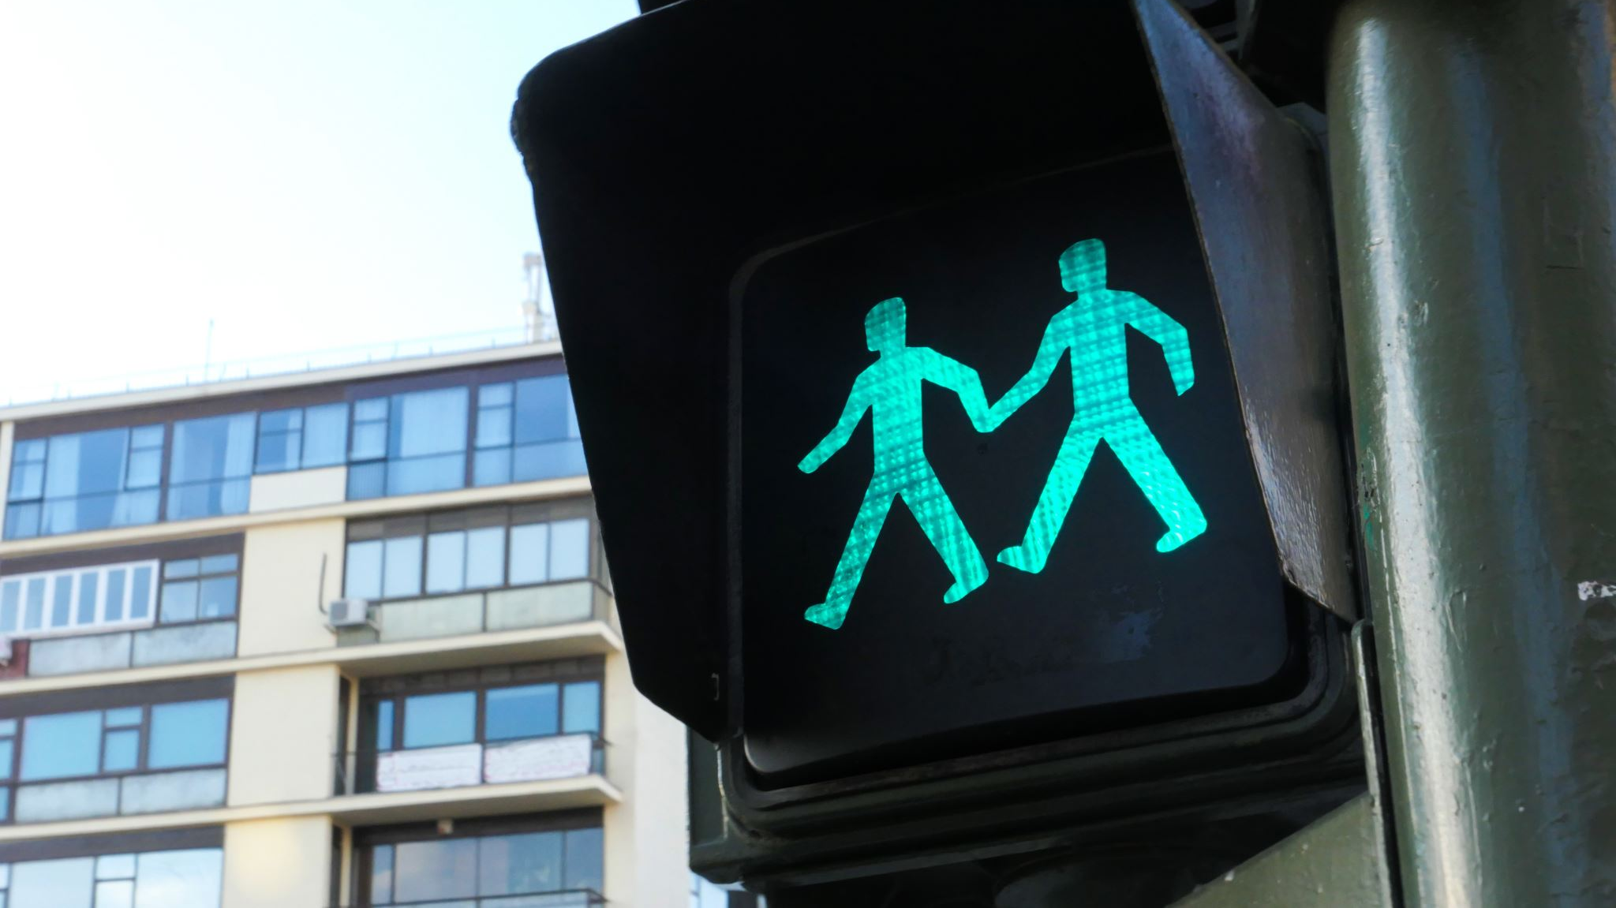
TRAFFIC SIGN RECOGNITION
TEAM 6 :
ASHRITHA KORUKANTI
SHASHANK
NIVAS REDDY Challa
HARINI KODATI
SOHAIL

Slide 2
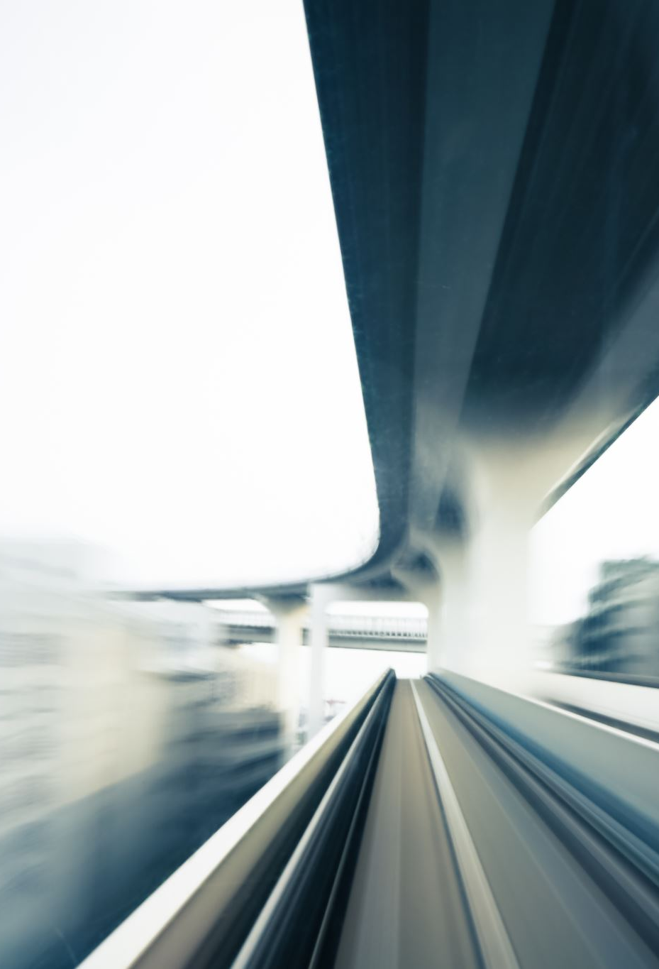
introduction TO TRAFFIC SIGN RECOGNITION
Traffic Sign Recognition (TSR) is a critical component of modern transportation systems, particularly in the realms of autonomous driving and Advanced Driver-Assistance Systems (ADAS). Its primary function is to automatically detect, interpret, and react to traffic signs in real-time, aiding both human drivers and autonomous vehicles in navigating roadways safely and efficiently.
TSR is a crucial component of autonomous driving systems and advanced driver-assistance systems (ADAS).
It involves detecting and classifying traffic signs in real-time from camera feeds.

Slide 3
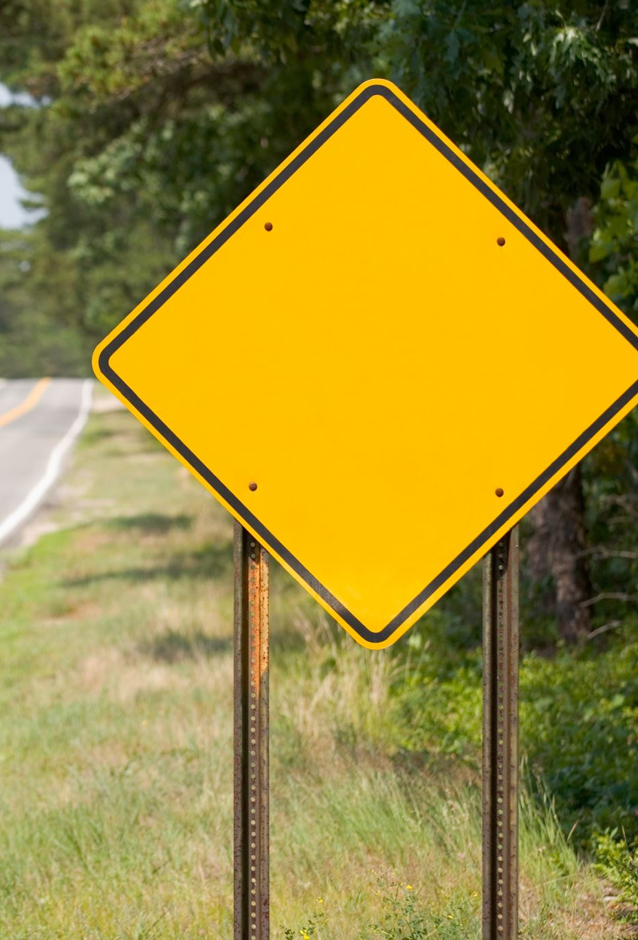
Challenges in traffic sign recognition
Varied lighting conditions, weather, and occlusions can make sign detection challenging.
Large number of sign variations, including different shapes, colors, and symbols.
Signs maybe partially blocked off or covered with the objects surrounding the area.

Slide 4

INTRODUCTION TO THE YOLO MODEL
YOLO is a popular object detection algorithm known for its speed and accuracy.
It processes images in a single pass through the neural network, making it efficient for real-time applications.
YOLO divides the input image into a grid and predicts bounding boxes and class probabilities for each grid cell.

Slide 5
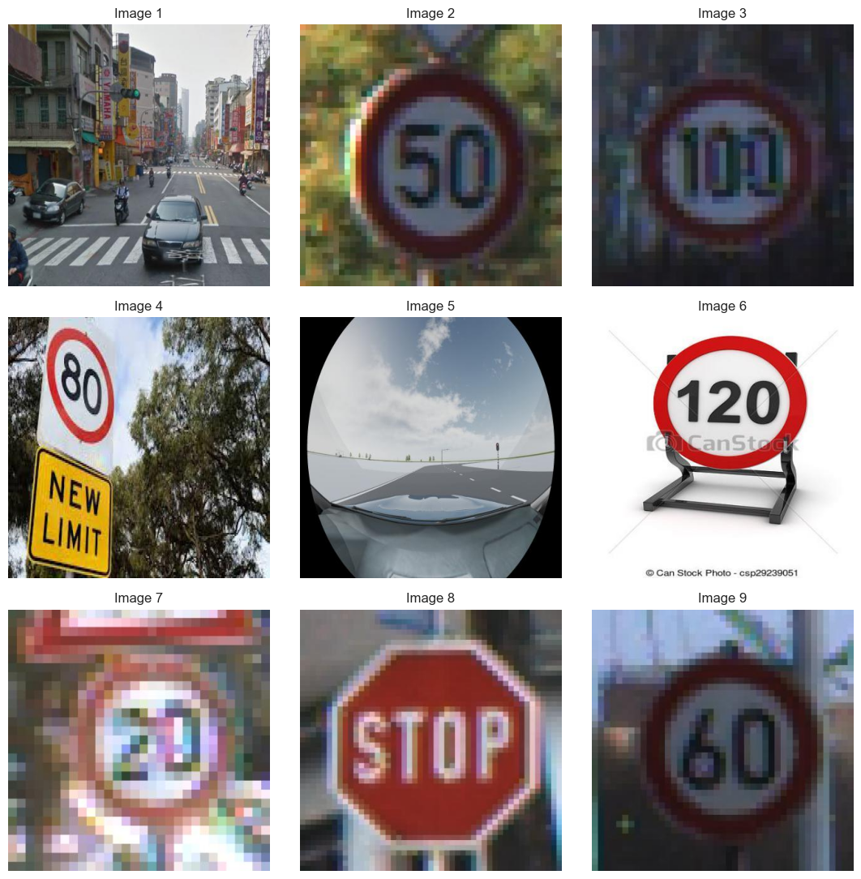
DISPLAYING 9 RANDOM IMAGES FROM TRAIN DATASET

Slide 6
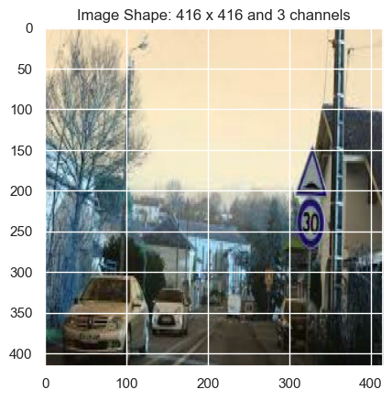
DISPLAYING THE SHAPE OF THE IMAGE

Slide 7
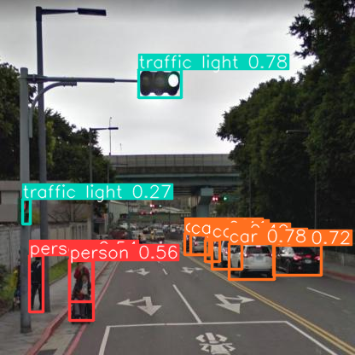
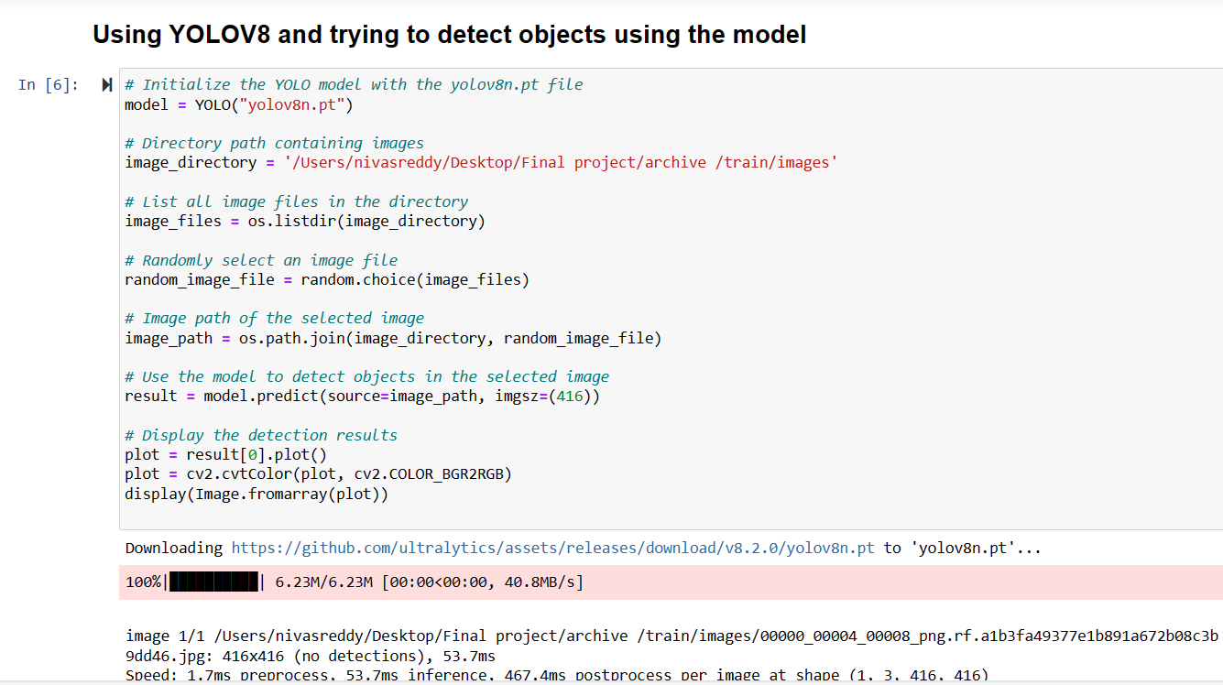
USING YOLOV8 AND TRYING TO DETECT OBJECTS

Slide 8
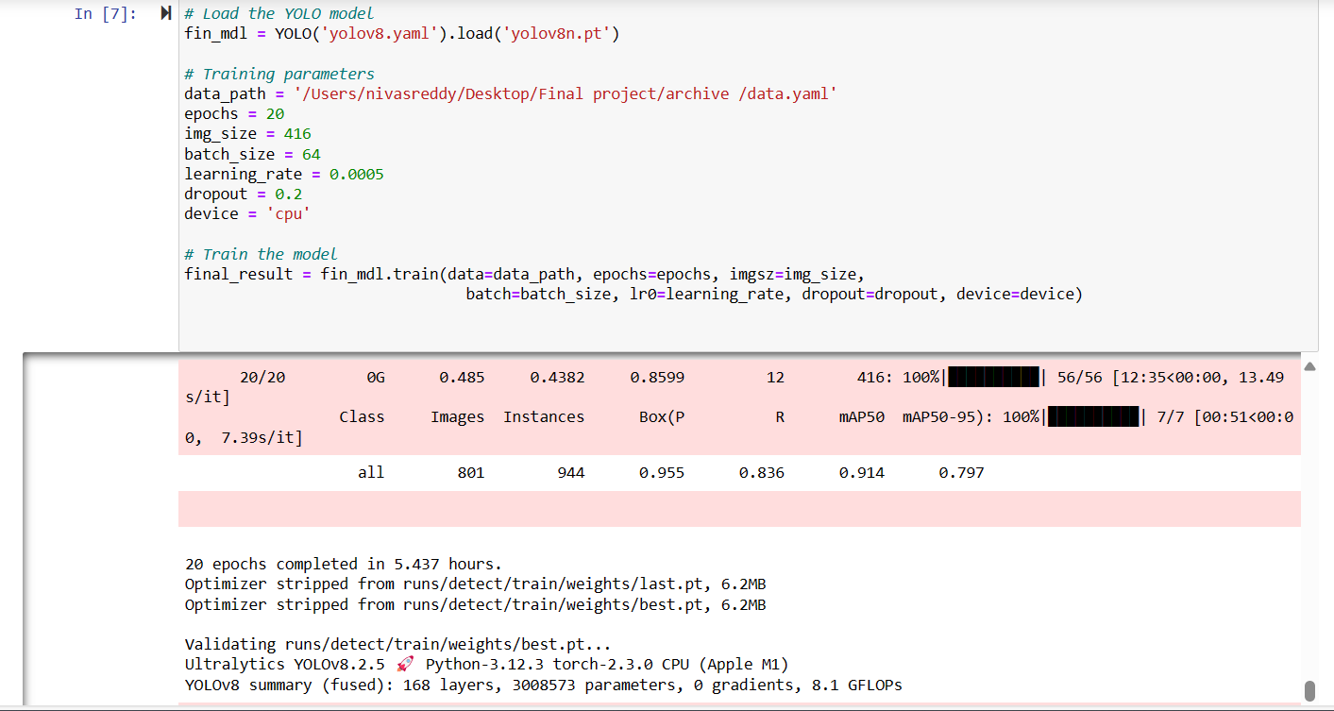
TRAINING THE MODEL

Slide 9
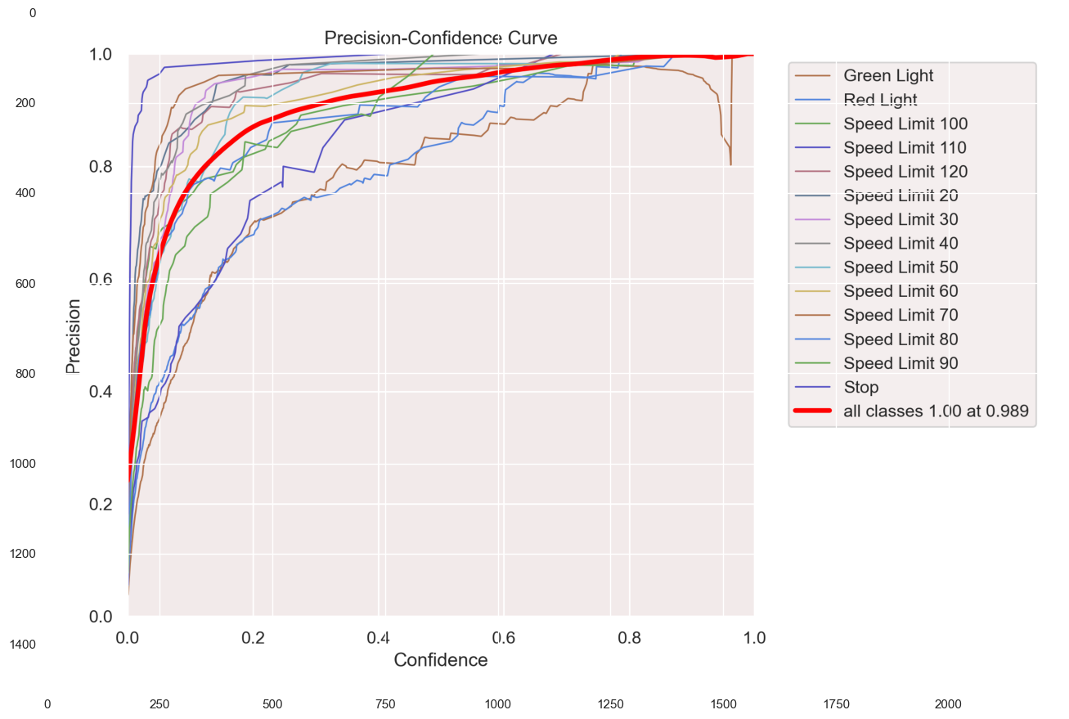
PRECISION-CONFIDENCE CURVE

Slide 10
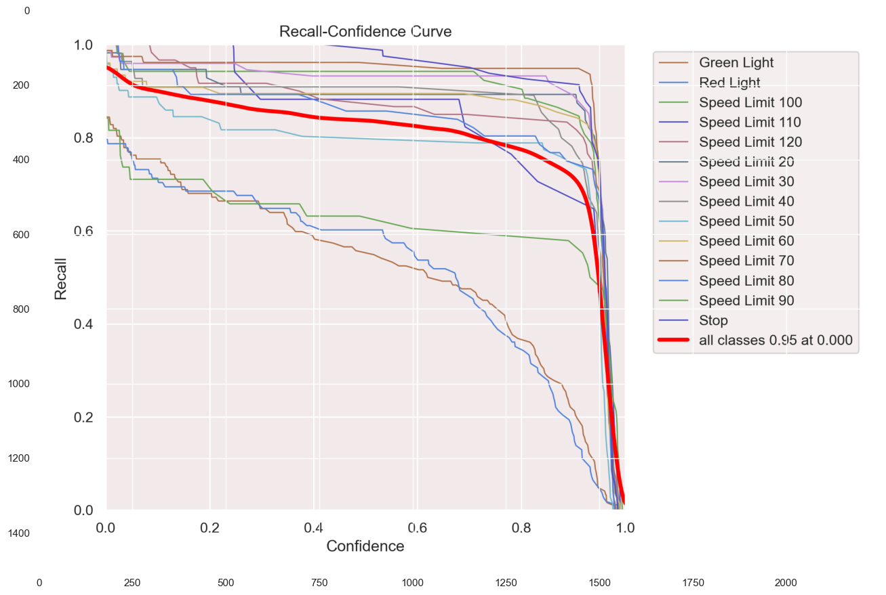
RECALL-CONFIDENCE CURVE

Slide 11
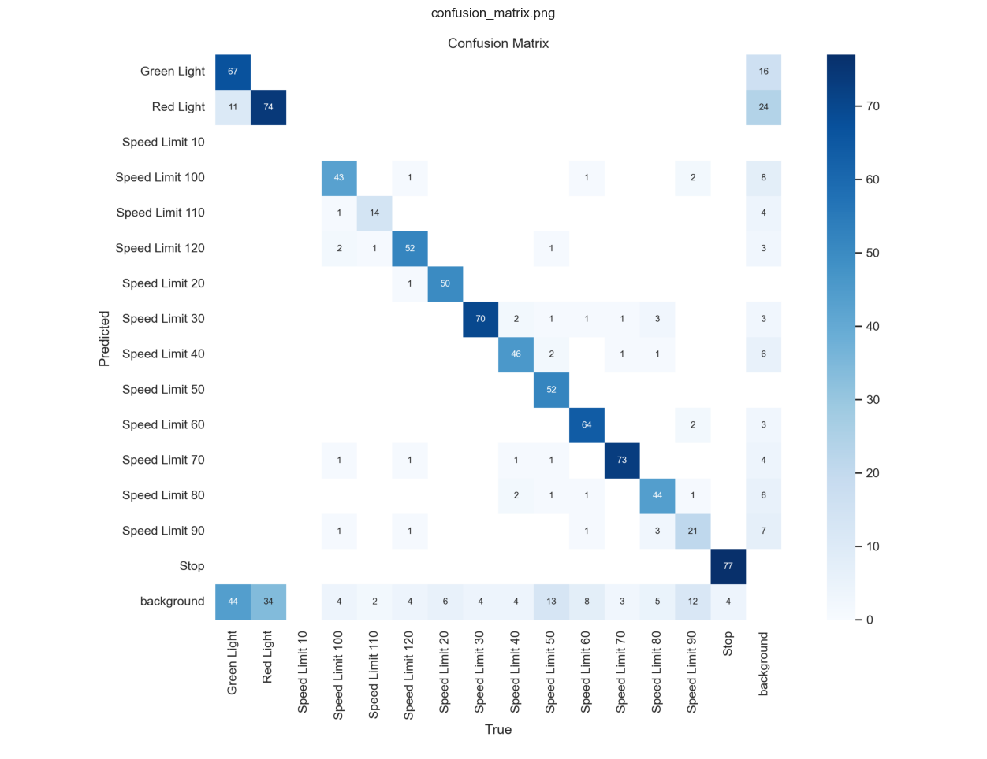
CONFUSION MATRIX

Slide 12
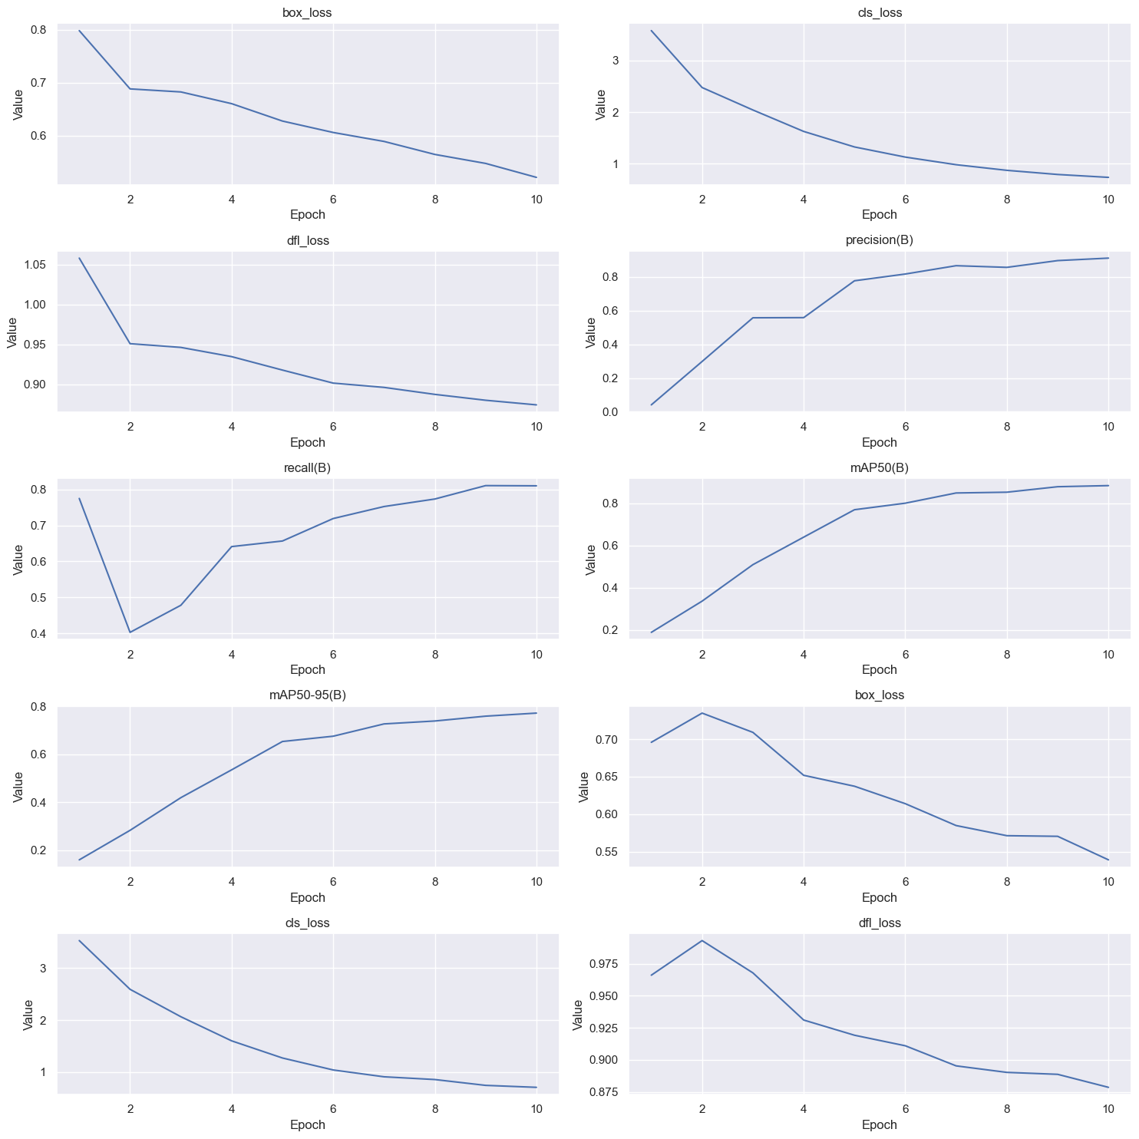
TRAINING METRICS AND LOSS

Slide 13
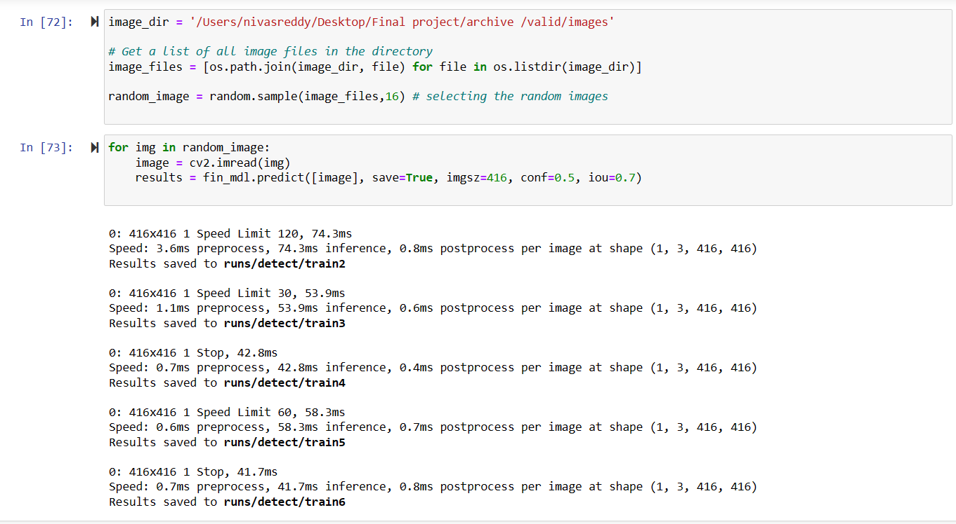
VALIDATING THE VALID DATASET

Slide 14
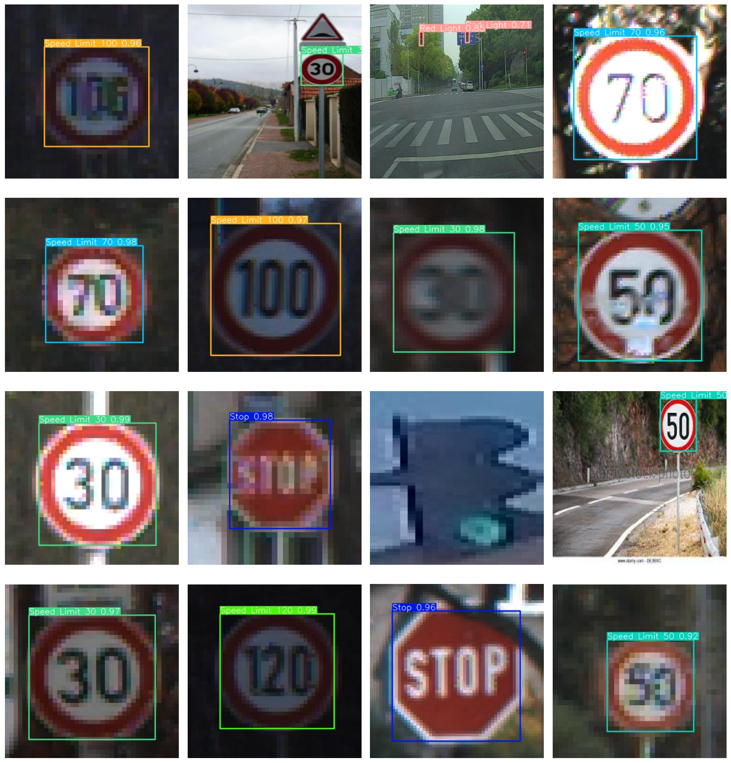
DISPLAYING IMAGES FROM THE VALID DATASET

Slide 15
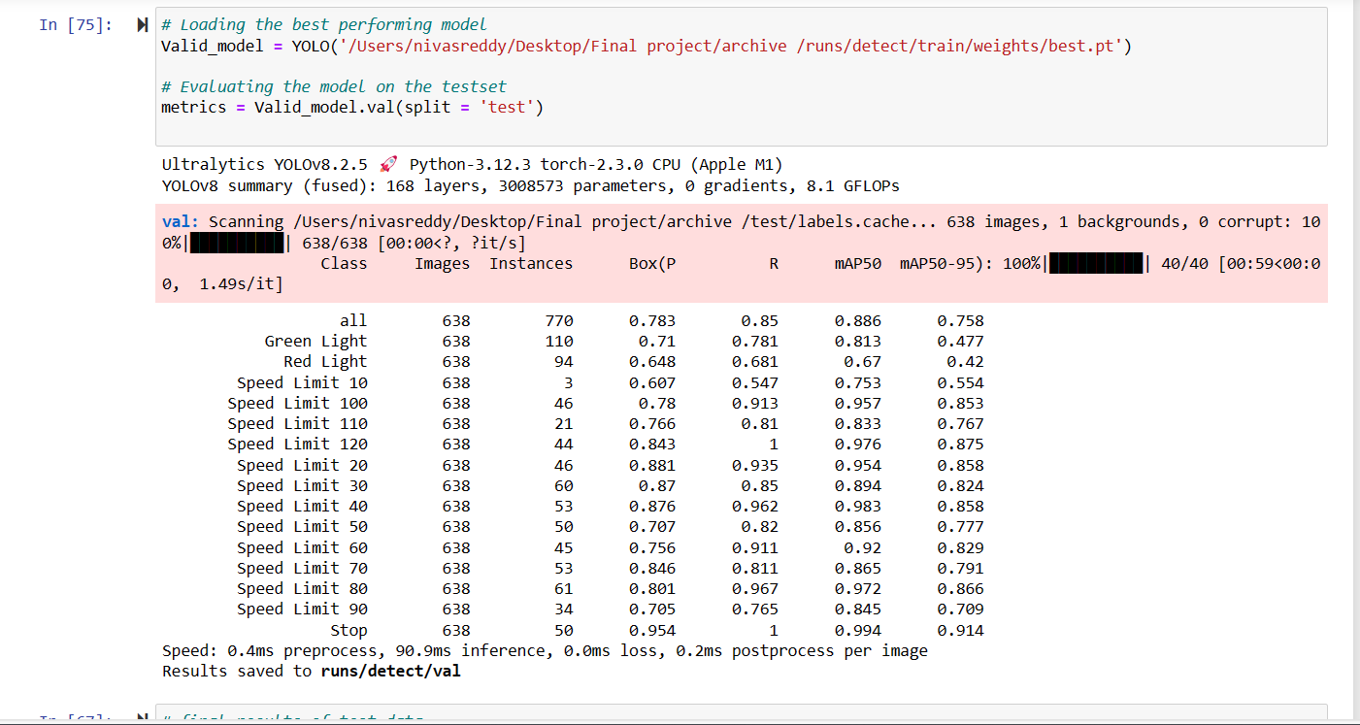
Validating the tEST datasets

Slide 16
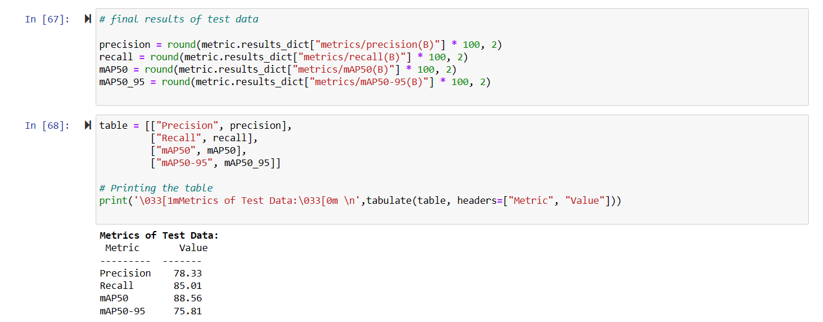
EVALUATION METRICS

Slide 17
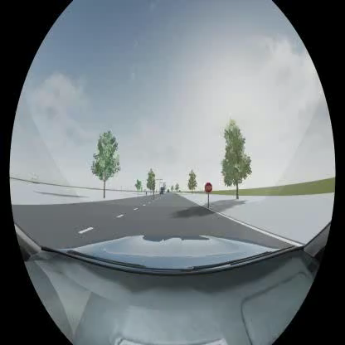
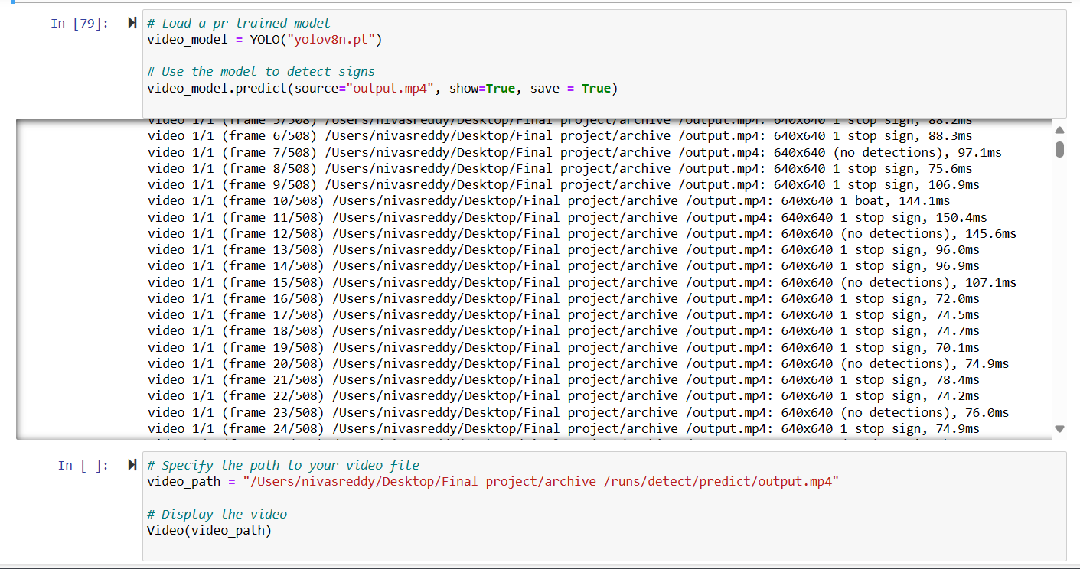
SAMPLE VIDEO TO TRAIN THE YOLOV8 MODEL

Slide 18
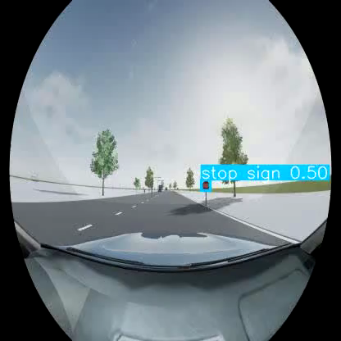
RESULTS OF THE SAMPLE VIDEO

Slide 19
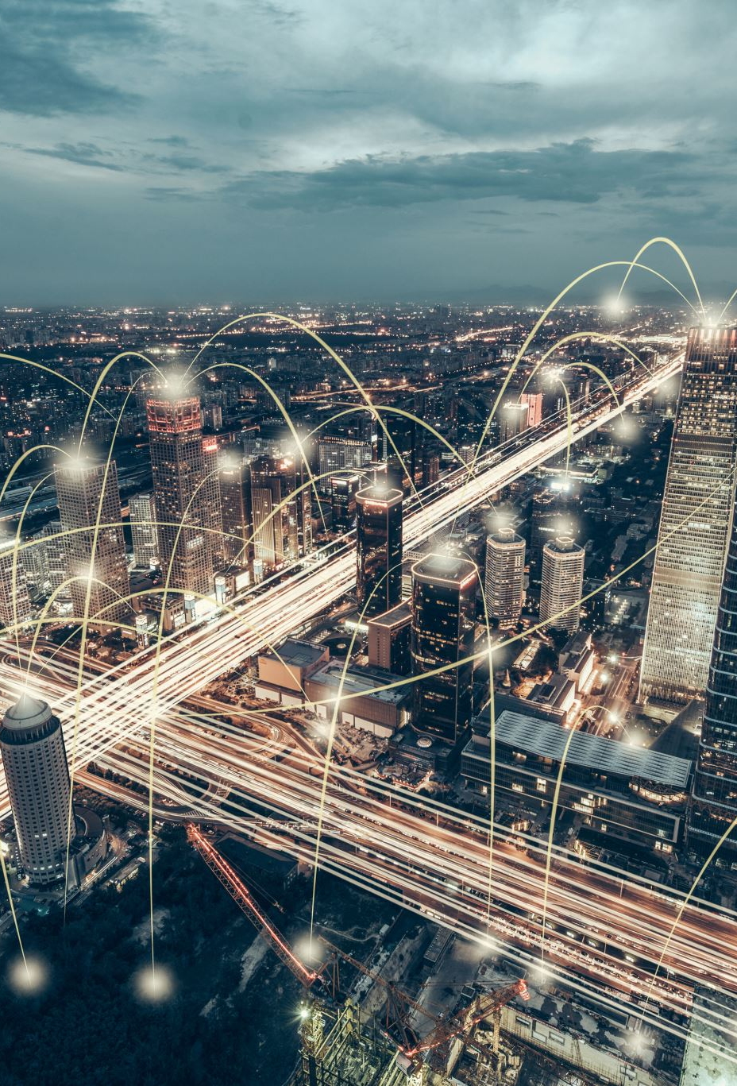
REAL WORLD APPLICATIONS
Autonomous vehicles
Advanced Driver-Assistance Systems (ADAS)
Traffic Management and Surveillance
Smart Cities and Infrastructure
Fleet Management and Logistics

Slide 20
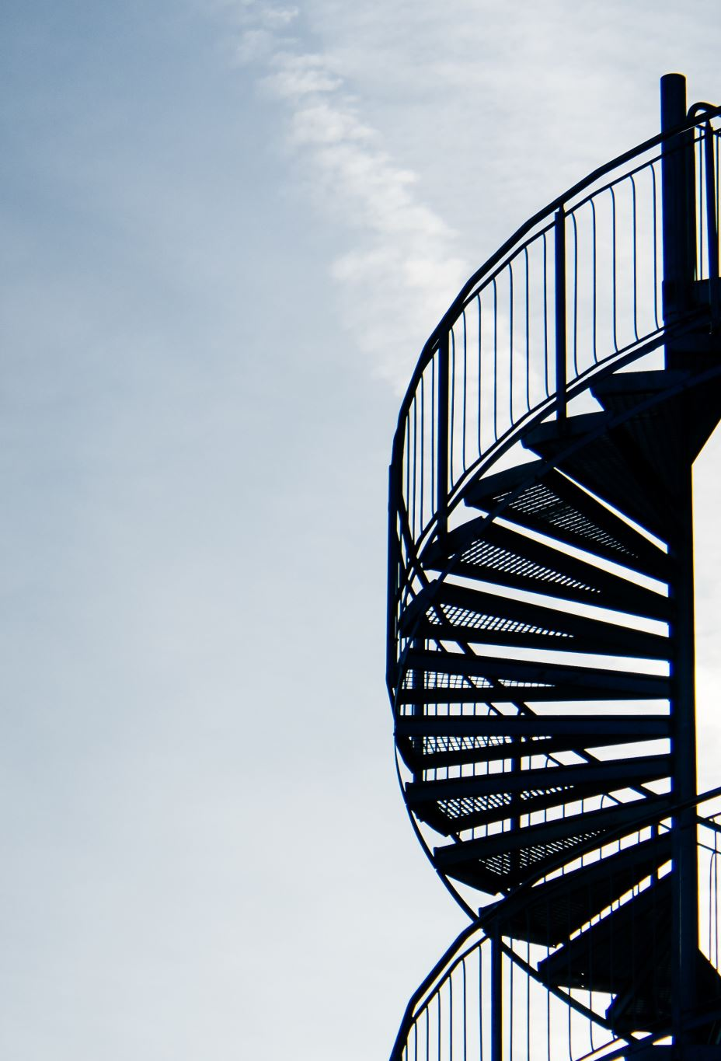
CONCLUSION
In conclusion, Traffic Sign Recognition is a critical component of modern transportation systems, with applications ranging from autonomous vehicles and ADAS to traffic management and smart cities. By harnessing the power of deep learning, sensor fusion, and real-time decision-making, TSR systems have the potential to revolutionize road safety, mobility, and sustainability in the years to come.
As we continue to innovate and collaborate across various industry sectors, we can collectively work towards realizing a future where Traffic Sign Recognition plays a central role in creating safer, smarter, and more connected transportation ecosystems for all.

Slide 21

Thank you

